Slide 1
UCSD Embedded C Assignment 3
By
Hsuankai Chang
hsuankac@umich.edu

Slide 2
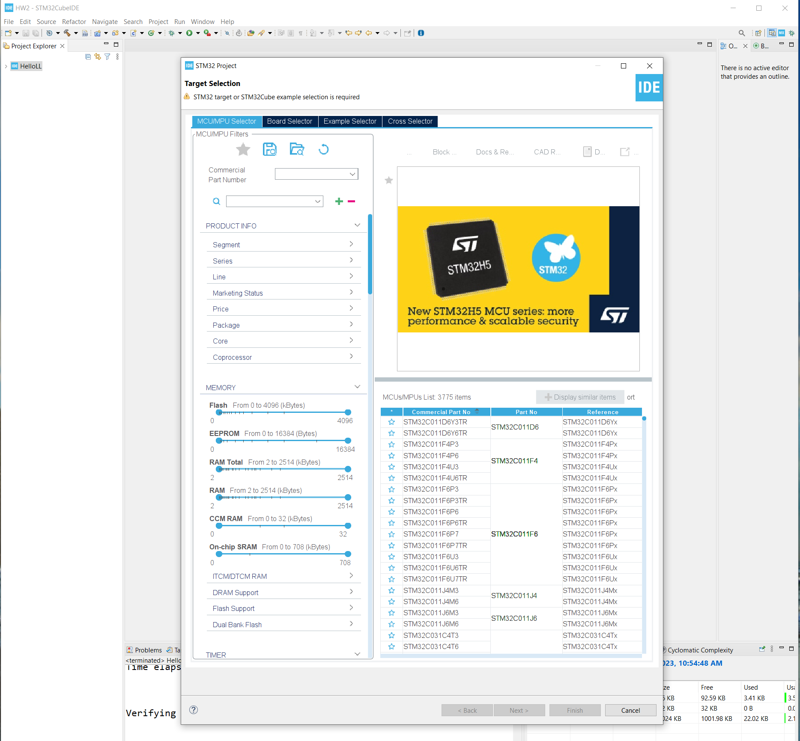
Step 1. Startup STM32CubeIDE and create new STM32 project

Slide 3
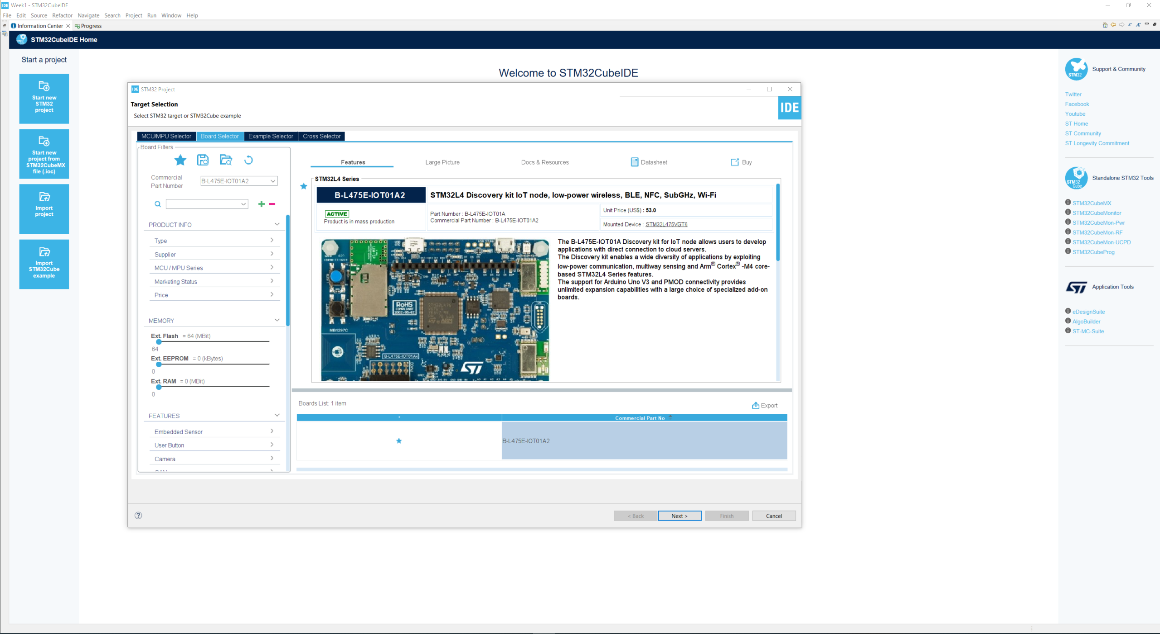
Step 2. Access board selector and type in the board you use, click Next

Slide 4
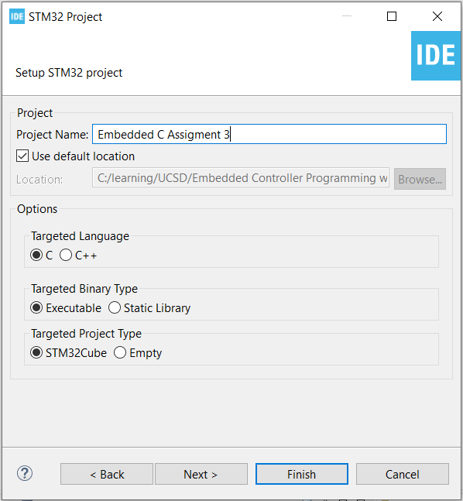
Step 3. Enter the project name then click Finish

Slide 5
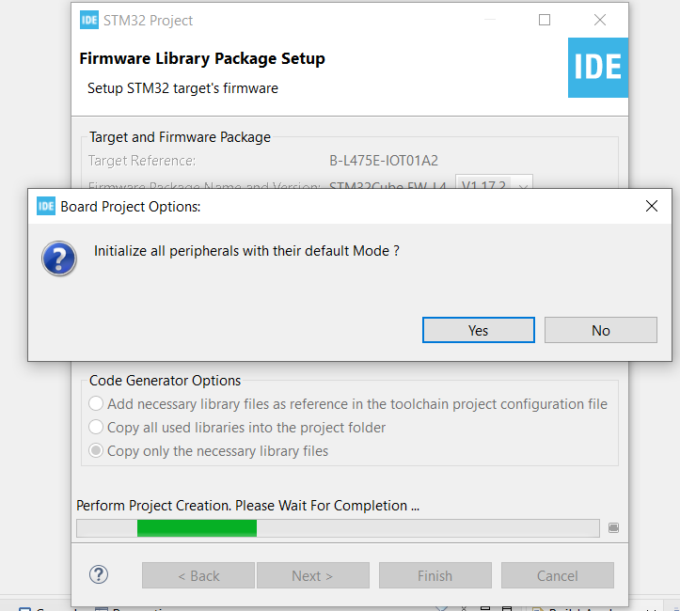
Step 4. Click yes to initialize all peripherals to default

Slide 6
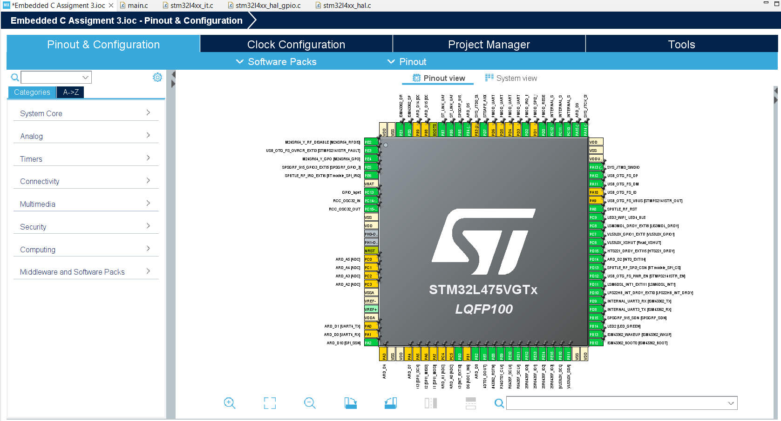
Step 5. When in .ioc file, click Pinout & Configurations, make sure BUTTON and LED2 are configured correctly

Slide 7
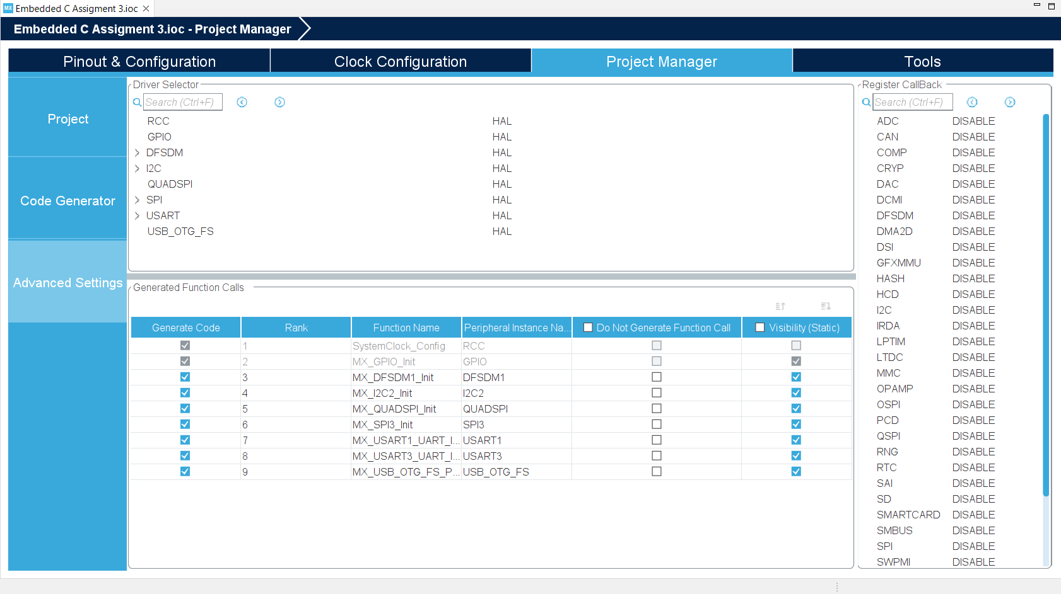
Step 6. Click Project Manager -> Advanced Settings -> Driver Selector, make sure the required driver use HAL

Slide 8
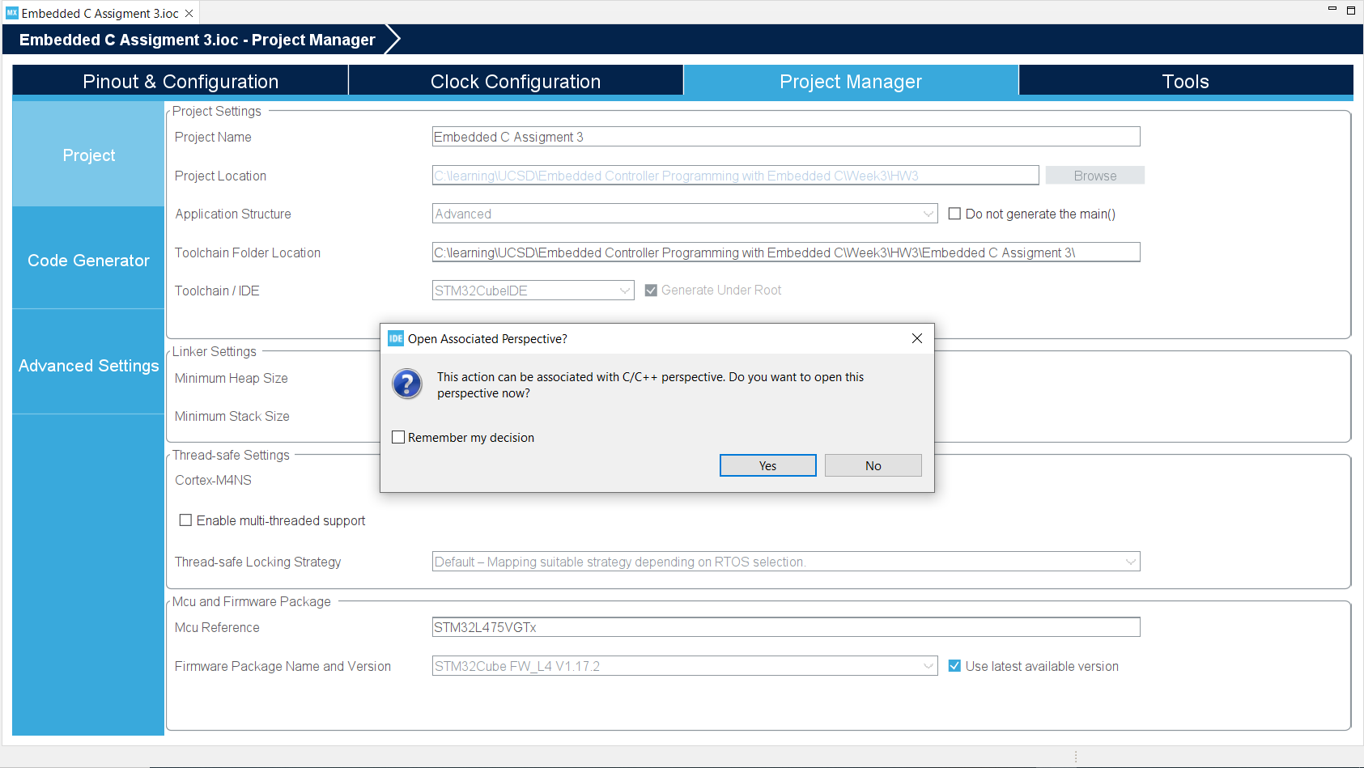
Step 7. Click yes to generate code and open in c/c++ perspective

Slide 9
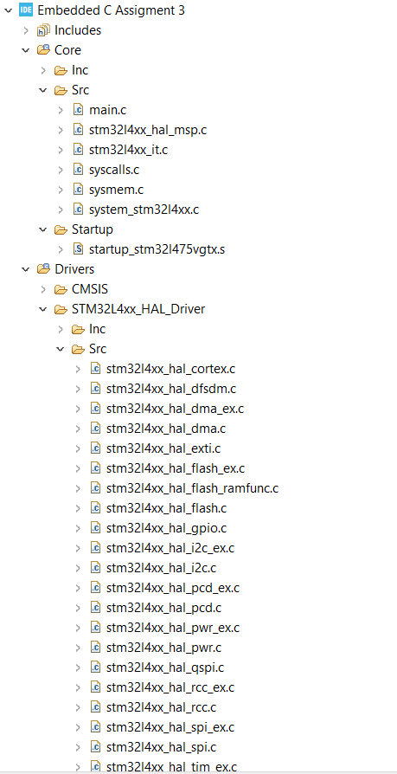
Step 8. Observe the result project structure

Slide 10
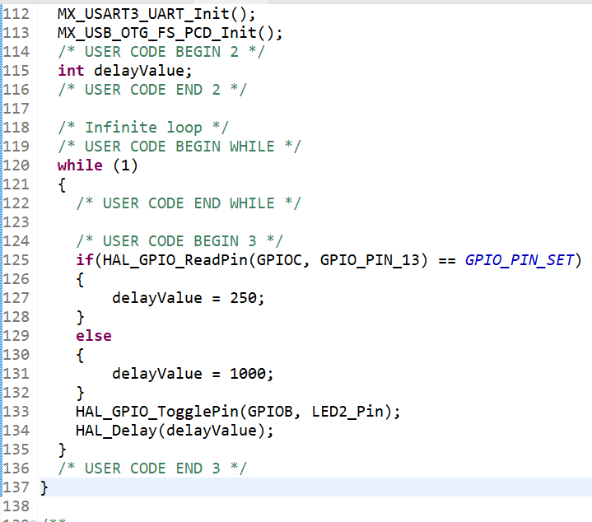
Step 9. Edit the code the main.c file, if BUTTON is in RESET state, toggle the LED2 pin in 1000ms, else, toggle in 250 ms

Slide 11
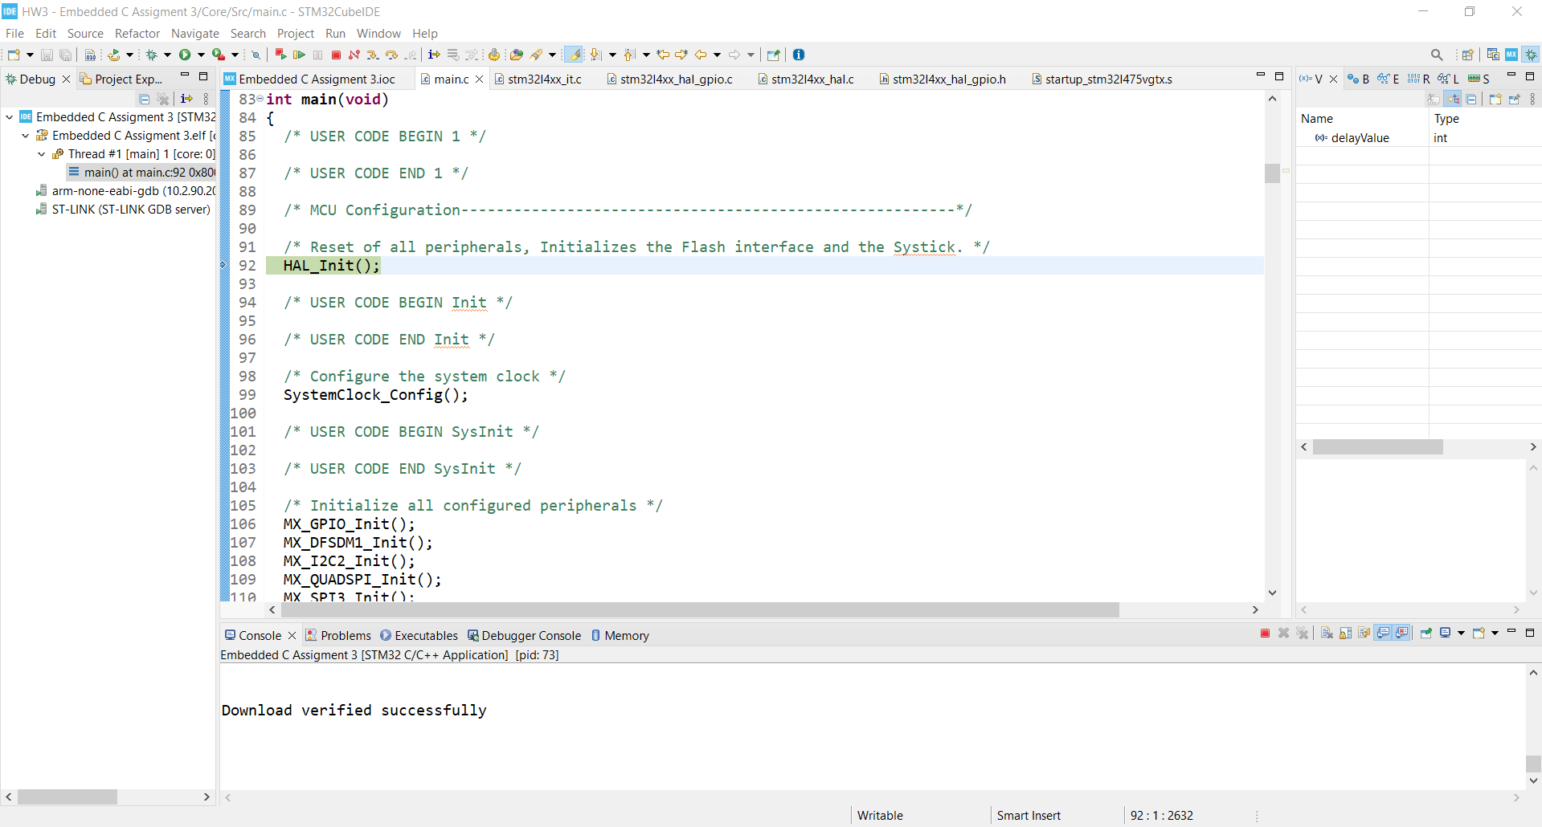
Step 10. Build the project, debug and run the code. When you push the user button, you should see the LED toggle rate change

